Slide 1

Online RP-FP Monitoring System
2016 Accomplishment Report

Slide 2
Online RP-FP Accomplishment Report FY 2016
Conducted Assessment of the Online RP-FP Monitoring System
March 8-11, 2016 @ Cebu City
Conducted Training and Orientation in the Optimization of Data and Server Performance of the Online RP-FP Monitoring System
June 13-17, 2016 @ Butuan City

Slide 3
Online RP-FP Accomplishment Report FY 2016
Accomplished updates as of December 31, 2016 as per discussion with the Regional Online RP-FP Monitoring System Administrators
Added date restriction in selecting a date beyond the current date
Added search parameter: Show All Couples and Show All Couples with Unmet Need
Included date encoded and Preferred Method to use columns
(FP User/Method)
Updated navigation by adding Jump function
Enhanced Approving and Deleting through multiple data selection
Additional search parameter in Pending Couples: Encoder Email
Added printing and downloading function in Pending Couples
Additional fields in encoding new couples: Extension Name and Participant Attended

Slide 4
Online RP-FP Accomplishment Report FY 2016
Accomplished updates as of December 31, 2016 as per discussion with the Regional Online RP-FP Administrators
Added Couples for Served module for multiple serving of couples
Added downloading of Couples data in PDF and Word format
Added Excel Notifications module for checking of excel errors
Added Deposit and Importing of couples data encoded in Excel Templates
Included auto update of record of LAM users and pregnant women to No Method, after 6 months and 9 months respectively, after date of conduct
Updates in the Excel Template:
changed separator to underscore ( _ )
Mark ( x ) under signature column if attended the class

Slide 5
Online RP-FP Accomplishment Report FY 2016
Accomplished updates as of December 31, 2016 as per discussion with the Regional Online RP-FP Administrators
Changed and fixed problem in the Data Mining report
Updated wrong spellings
Included color coding for Served, Unmet Need, Duplicate and No Intention and included Legend
Adjusted font color of text to make it readable
Fixed problem with missing couples after editing their data
Fixed problem with error message and dropdown menu in creating new couples data
Fixed problem with labelling of couples as unmet need
Updated report generated in the Search by Couples page

Slide 6
Online RP-FP Accomplishment Report FY 2016
Accomplished updates as of December 31, 2016 as per discussion with the Regional Online RP-FP Administrators
Added Homepage
Included the Online RP-FP Monitoring System – Public Dashboard in the POPCOM Website
Added User Role: Partners
Additional Field: Indigenous Person
Additional RHUs/CSOs user accounts

Slide 7
Online RP-FP Accomplishment Report FY 2016
Some clarifications were answered
Couples parameter: Age is not working
– need to indicate Looking for: husband or wife
Applies to other indicators like Civil Status and Occupation
Unmet Need – are Non-FP users that are:
All Traditional Users, or
No Method with intention to use
Birthday fields with no data must be manually edited – cause of problem is wrong encoding of birthdate
User accounts that are no longer active must not be deleted but changed to inactive status
Manual editing of Date Conducted for wrong inputs

Slide 8
Updates in the Dissemination of RHU and CSO Accounts
Region / Office | Actual Number of Accounts |  | Disseminated Accounts |  | Active Accounts |  | Remarks
 | RHUs | CSOs | RHUs | CSOs | RHUs | CSOs
POPCOM 1 | 125 | 2 | 125 | 2 | 125 | 2 | done
POPCOM 2 | 93 | 2 | 0 | 0 | 0 | 0 | Orientation for the RHUs and CSOs is set on February and March 2017
POPCOM 3 | 130 | 2 | 0 | 1 | 0 | 1 | Orientation for the RHUs is set on February 2017
POPCOM 4A | 142 | 3 | 142 | 3 | 142 | 3 | done
POPCOM 4B | 73 | 3 | 73 | 3 | 73 | 3 | done
POPCOM 5 | 115 | 0 | 0 | 0 | 0 | 0 | Orientation is set on the 1st RPMC on Jan.31-Feb 2,2017; Problem with internet connection in some RHUs
POPCOM 6 | 101 | 1 | 0 | 1 | 0 | 1 | Orientation for the RHUs is set on February 2017

Slide 9
Updates in the Dissemination of RHU and CSO Accounts
Region / Office | Actual Number of Accounts |  | Disseminated Accounts |  | Active Accounts |  | Remarks
 | RHUs | CSOs | RHUs | CSOs | RHUs | CSOs
POPCOM 7 | 107 | 2 | 0 | 0 | 0 | 0 | Dissemination of Accounts for RHUs during the Prov. RIT Mtg. on Feb. 3,6,16 & 28, and during RPMC on March 2017
POPCOM 8 | 143 | 1 | 0 | 0 | 0 | 0 | CSO already has an account; No plans yet for RHUs
POPCOM 9 | 72 | 1 | 0 | 0 | 0 | 0 | Orientation for the RHUs is set on February 2017
POPCOM 10 | 93 | 1 | 0 | 0 | 0 | 0 | Problem with internet connection and lack of personnel; PPOs and CPOs are already capacitated; POPCOM 10 will be disseminating the list of unmet need to RHUs and BPVs
POPCOM 11 | 49 | 1 | 0 | 1 | 0 | 1 | Orientation conducted; Dissemination will be done during the Provincial Project Implementation Review on Jan. 24-31, 2017

Slide 10
Updates in the Dissemination of RHU and CSO Accounts
Region / Office | Actual Number of Accounts |  | Disseminated Accounts |  | Active Accounts |  | Remarks
 | RHUs | CSOs | RHUs | CSOs | RHUs | CSOs
POPCOM 12 | 50 | 1 | 0 | 1 | 0 | 1 | Problem with internet connection; Orientation for the RHUs is set on February 2017
Caraga | 73 | 4 | 0 | 0 | 0 | 0 | Orientation for the RHUs is set on February 2017
CAR | 78 | 1 | 4 | 1 | 4 | 1 | Generating of reports and updating of service is done by POPCOM
NCR | 17 | 4 | 2 | 0 | 2 | 0 | Concern with confidentiality issues; Not yet engaged with any CSO
ARMM | 116 | 0 | 0 | 0 | 0 | 0 | Problem with internet connection
NIR | 57 | 0 | 0 | 0 | 0 | 0 | included in POPCOM 6 and POPCOM 7 plans

Slide 11
Couples Reached, Unmet Need and Served (2014-2016)

Slide 12
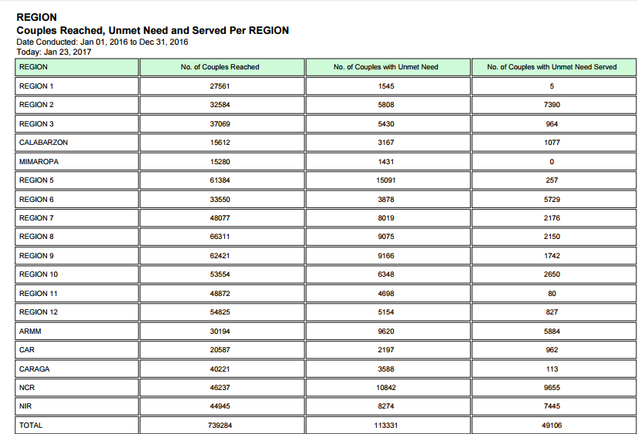

Slide 13
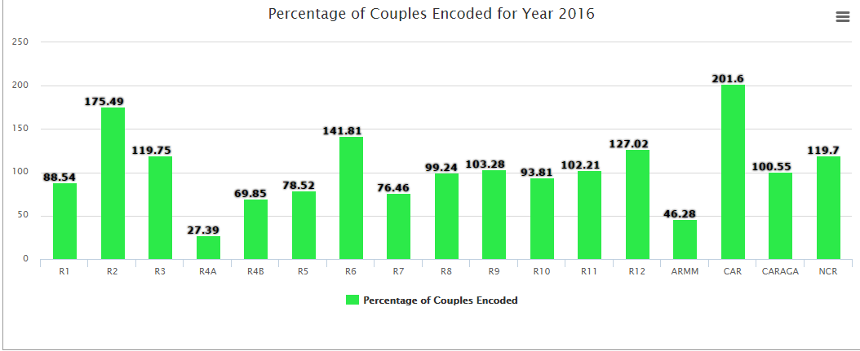

Slide 14
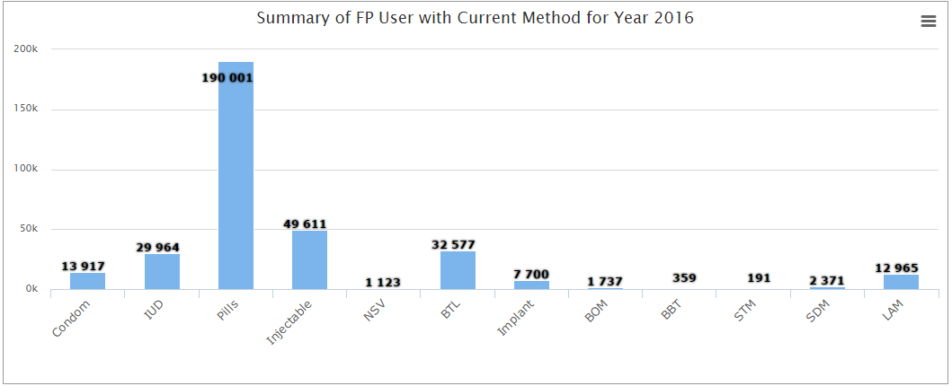

Slide 15
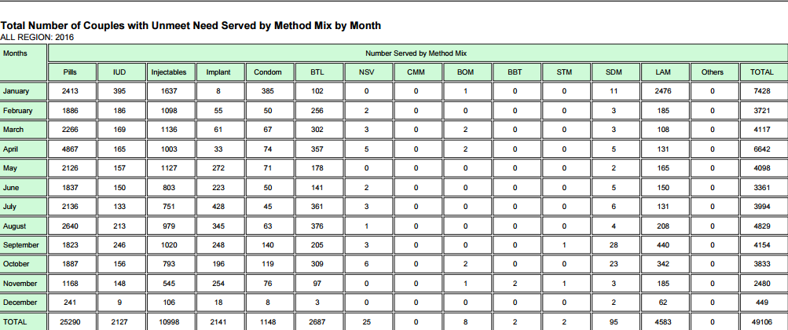

Slide 16
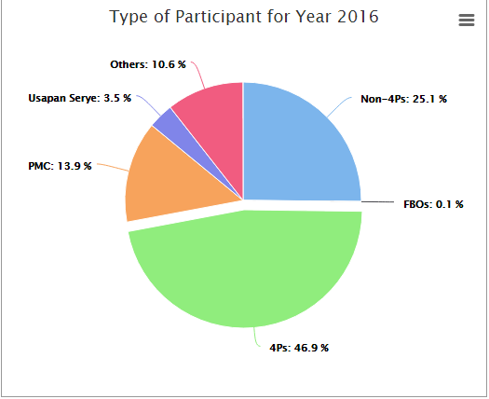

Slide 17
Thank You!

